Slide 1




Next Gen Employability Program
Full Stack Web Development with AI Tools
Team Details – NG_CP_Team_686
Name: Vaibhav Sharma
Name: Shaurya Negi
Name: Vartika Sharma
College: Inderprastha Engineering College, Ghaziabad

Slide 2

The content is curated from online/offline resources and used for educational purpose only.
Notes:
Speaker would be briefing the students that this content has been prepared for the educational purpose only and is referred from multiple sites which are cited in the last.​​
---------------------------------------------------​​
A disclaimer is a statement or notice that is intended to clarify, limit, or provide information about the scope, limitations, or potential risks associated with certain actions, information, products, services, or content. ​​
​​
​

Slide 3

Project Title
Connect2Give
Notes:
In this slide speaker will be introducing the program and its outcomes. The speaker will introduce himself in brief

Slide 4
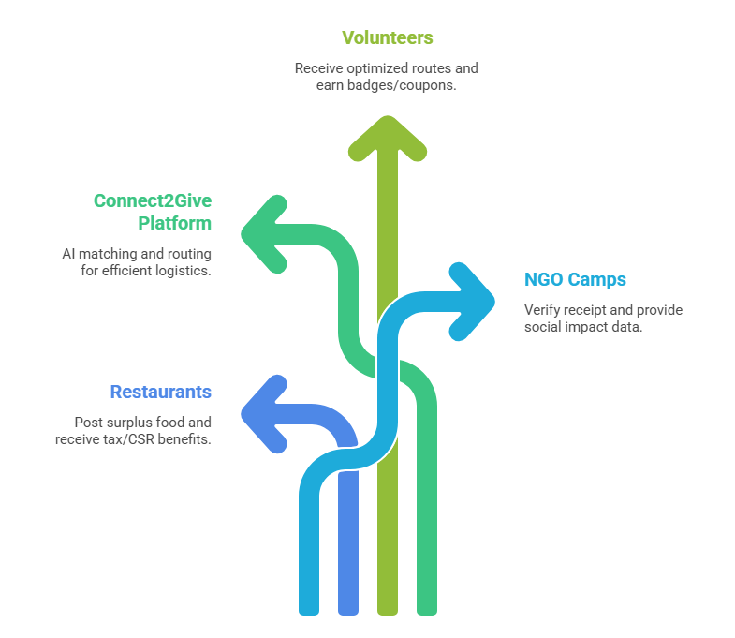
Table of Contents
01
Introduction
Platform overview and mission
02
Problem Statement
Current challenges in food distribution
03
Core Modules
Technical architecture and features
04
Proposed Solution
Key features and innovations
05
System Workflow
End-to-end process visualization
06
References
Technologies and resources
Notes:
This slide, The speaker will talk about the content that we will be covering in this session as follows:
Introduction
Importance of UI/UX in industry
History and Definitions of UI and UX
Key Differences between UI/UX
Use Cases
Significance in Web Development
Use Cases
Visual Design Principles
Design process
Color theory and psychology
Typography and readability
Layout and Spacing
Responsive design basics
Usability and Accessibility
Usability Aspects
Web Content Accessibility Guidelines (WCAG)
Inclusive design practices
Consistency
User Experience
User-Centered Design
User research methods
Interactive Elements and Feedback
Mini Case Study
Discussing a popular UI/UX design
Hands-On
Introduction to Figma for UI/UX design

Slide 5

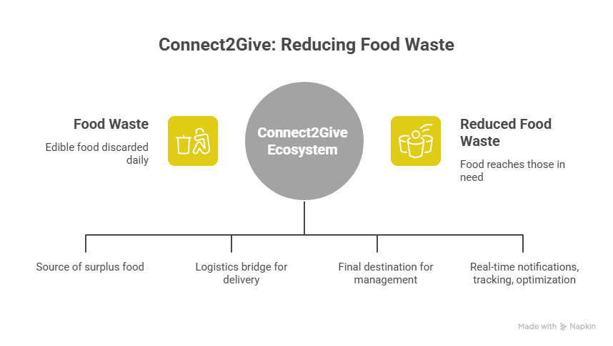
Introduction
Connect2Give is a comprehensive web platform built to streamline food redistribution by connecting food donors, NGOs, and volunteers through a unified digital system. The platform enables real-time coordination, transparent tracking, and efficient delivery workflows, ensuring surplus food is managed responsibly and reaches the right people at the right time.
Notes:
This slide, The speaker will talk about the content that we will be covering in this session as follows:
Introduction
Importance of UI/UX in industry
History and Definitions of UI and UX
Key Differences between UI/UX
Use Cases
Significance in Web Development
Use Cases
Visual Design Principles
Design process
Color theory and psychology
Typography and readability
Layout and Spacing
Responsive design basics
Usability and Accessibility
Usability Aspects
Web Content Accessibility Guidelines (WCAG)
Inclusive design practices
Consistency
User Experience
User-Centered Design
User research methods
Interactive Elements and Feedback
Mini Case Study
Discussing a popular UI/UX design
Hands-On
Introduction to Figma for UI/UX design

Slide 6
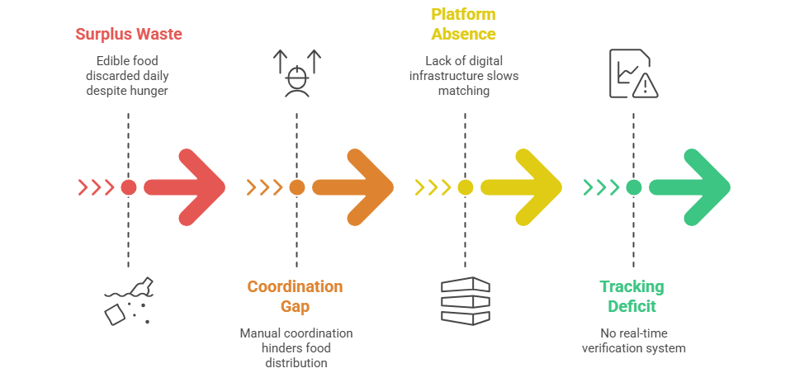
Problem Statement
India wastes nearly 78 million tonnes of food every year, with restaurants and large events as major contributors
India ranks 102nd out of 123 countries in the 2025 Global Hunger Index with a “serious” hunger score.
This shows a serious gap in coordination and food redistribution, where edible food fails to reach those in need
The absence of real-time digital systems makes timely food collection, tracking, and delivery inefficient
Notes:
This slide, The speaker will talk about the content that we will be covering in this session as follows:
Introduction
Importance of UI/UX in industry
History and Definitions of UI and UX
Key Differences between UI/UX
Use Cases
Significance in Web Development
Use Cases
Visual Design Principles
Design process
Color theory and psychology
Typography and readability
Layout and Spacing
Responsive design basics
Usability and Accessibility
Usability Aspects
Web Content Accessibility Guidelines (WCAG)
Inclusive design practices
Consistency
User Experience
User-Centered Design
User research methods
Interactive Elements and Feedback
Mini Case Study
Discussing a popular UI/UX design
Hands-On
Introduction to Figma for UI/UX design

Slide 7
Core Modules
Connect2Give's technical architecture consists of four integrated modules that work together to create a seamless food donation ecosystem.
User Management
Route Optimization
Role-based access control for Admins, Restaurants, NGOs, and Volunteers with secure authentication using Django Allauth and Google OAuth integration
Intelligent routing engine using Nearest Neighbor Algorithm and Geodesic distance calculations to minimize volunteer travel time and maximize delivery efficiency
1
2
3
4
Donation Management
Delivery Verification
Complete lifecycle tracking from Pending to Verified, with a transparent verification system where NGOs validate food quality and receipt
To ensure accountability, NGOs have the ability to verify and approve food deliveries upon arrival, as well as rate volunteer performance.

Slide 8

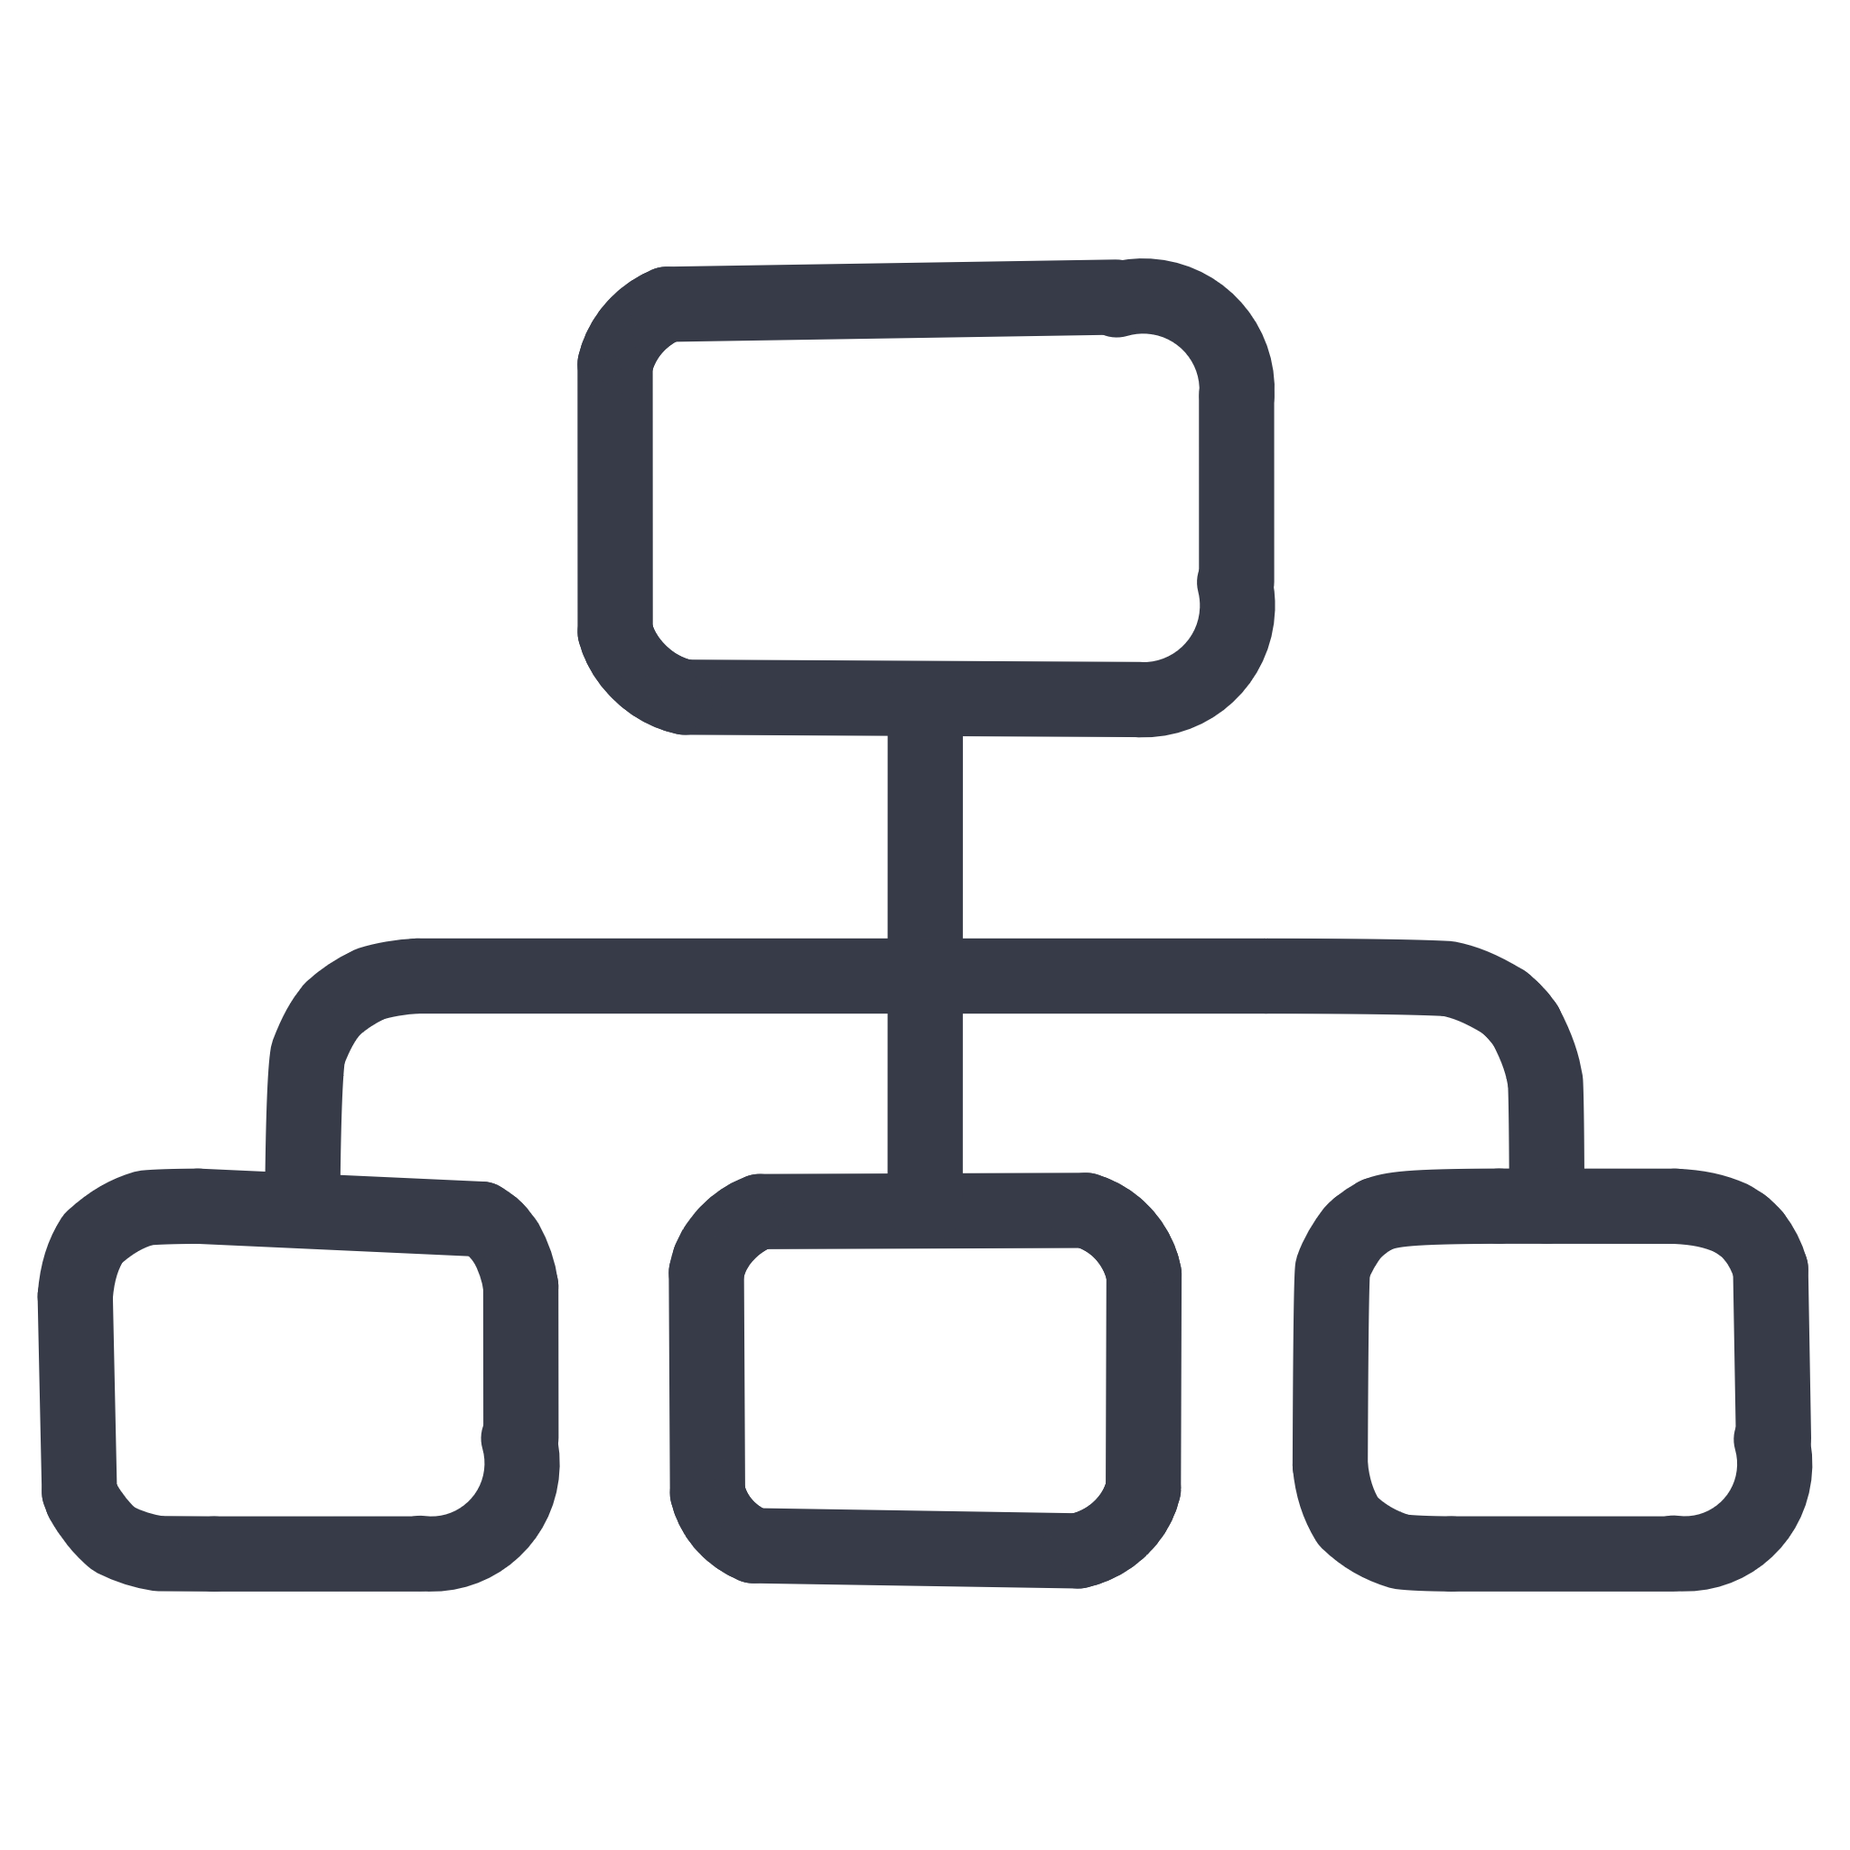


Proposed Solution
Connect2Give is a centralized digital platform that connects food donors, NGOs, and volunteers in real time to redistribute surplus food efficiently. Donors list excess food with expiry and location details, nearby NGOs receive instant notifications, and volunteers are automatically assigned for quick pickup and delivery. By enabling real-time coordination, location-based matching, and transparent tracking, Connect2Give reduces food waste and ensures timely delivery to communities in need.
Smart Routing
Interactive Maps
Optimized delivery paths to nearest camps reduce travel time and prevent food spoilage
Leaflet.js and OpenStreetMap integration visualizes donation camps and restaurant locations in real-time
Google Authorization
Transparency
Google authentication enables secure, one-tap sign-in while verifying genuine users across the platform.
Digital verification process with NGO confirmation before closing the donation cycle
Notes:
This slide, The speaker will talk about the content that we will be covering in this session as follows:
Introduction
Importance of UI/UX in industry
History and Definitions of UI and UX
Key Differences between UI/UX
Use Cases
Significance in Web Development
Use Cases
Visual Design Principles
Design process
Color theory and psychology
Typography and readability
Layout and Spacing
Responsive design basics
Usability and Accessibility
Usability Aspects
Web Content Accessibility Guidelines (WCAG)
Inclusive design practices
Consistency
User Experience
User-Centered Design
User research methods
Interactive Elements and Feedback
Mini Case Study
Discussing a popular UI/UX design
Hands-On
Introduction to Figma for UI/UX design

Slide 9
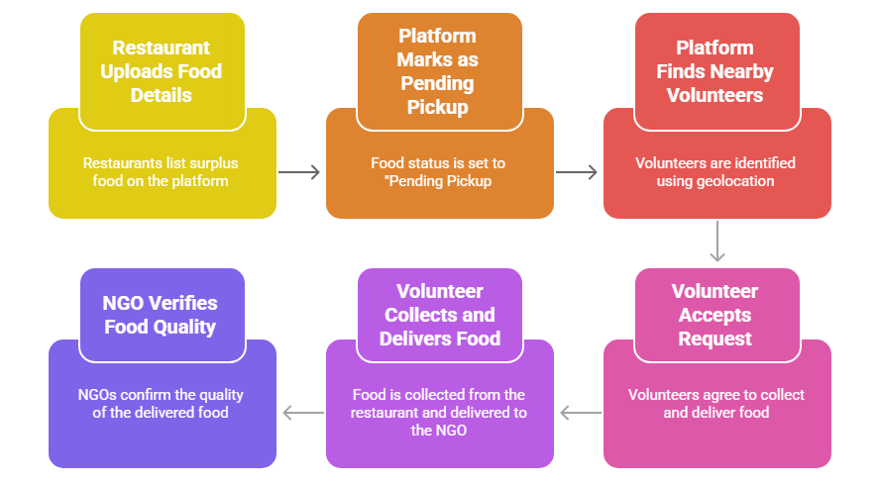
Flowchart
The Connect2Give platform orchestrates a seamless seven-step process from food posting to verified delivery, ensuring transparency and efficiency at every stage.
This streamlined process ensures accountability through real-time status updates and verification checkpoints, reducing food waste while maximizing community impact. The integrated rating system creates a feedback loop that maintains high service quality across the network.

Slide 10
References
Technology Foundation
Learning Resources
W3Schools - Web JavaScript
W3Schools - Django Framework
Leaflet.js Documentation
Python 3.11.9 Official Release
GeeksforGeeks - Backend Development
Backend Framework - Django 5.2.7, Django REST Framework, MySQL
Real-time & Async - Redis, Django Channels, PyWebPush
Mapping & Location - Leaflet.js, OpenStreetMap, GeoPy
Frontend - HTML5, CSS3, JavaScript (ES6+)
Notes:
This slide, The speaker will talk about the content that we will be covering in this session as follows:
Introduction
Importance of UI/UX in industry
History and Definitions of UI and UX
Key Differences between UI/UX
Use Cases
Significance in Web Development
Use Cases
Visual Design Principles
Design process
Color theory and psychology
Typography and readability
Layout and Spacing
Responsive design basics
Usability and Accessibility
Usability Aspects
Web Content Accessibility Guidelines (WCAG)
Inclusive design practices
Consistency
User Experience
User-Centered Design
User research methods
Interactive Elements and Feedback
Mini Case Study
Discussing a popular UI/UX design
Hands-On
Introduction to Figma for UI/UX design

